Slide 1









Pico Safari
Peter Organisciak[1], Garry Wong [2], Calen Henry [2], Lucio Gutierrez [2]
[1] University of Illinois at Urbana Champaign, [2] University of Alberta
Active Gaming in Integrated Environments
May 30, 2011

Slide 2
Artificial experiences subtly change the way we feel, perceive, interpret, and even describe our “real” experiences.
-David Rockeby
“The Construction of Experience : Interface as Content”, 1998

Slide 3

Picos are imaginary creatures that hold a place in the physical world.

Slide 4
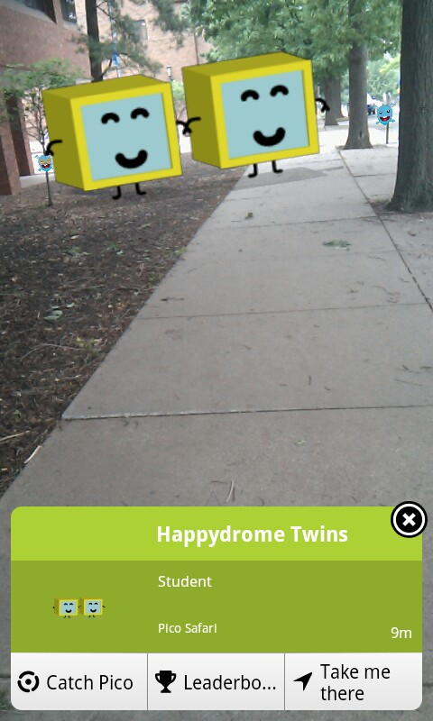
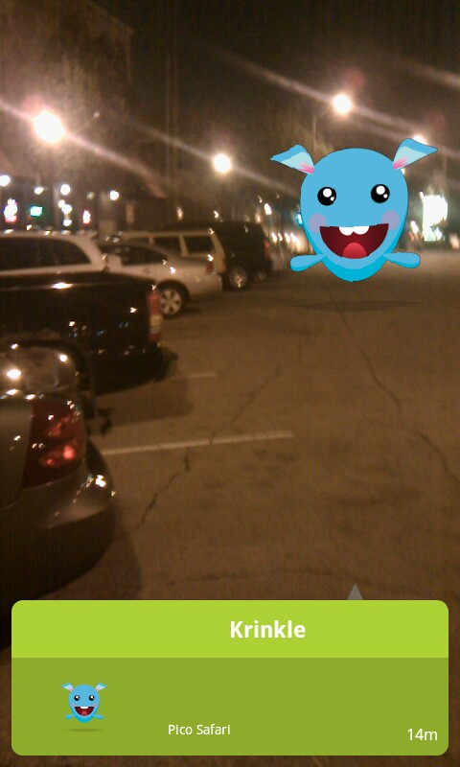
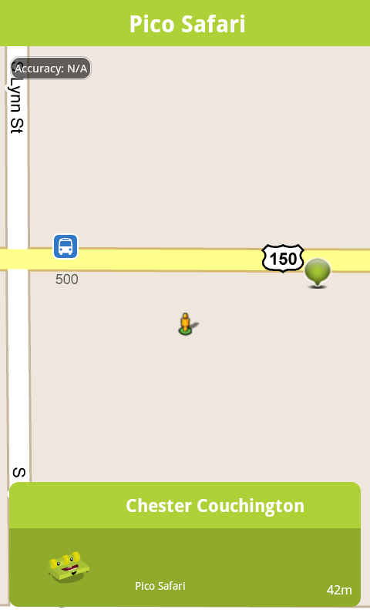

Slide 5

Augmented Alternate Reality Gaming

Slide 6
Augmented Alternate Reality Gaming
AARG!!

Slide 7
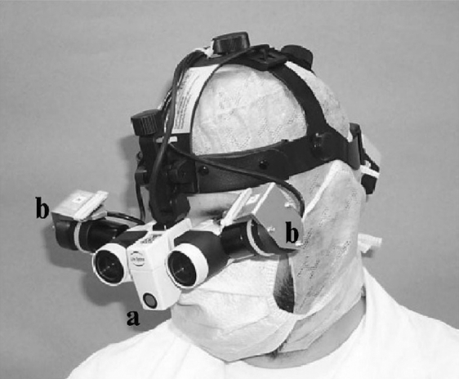
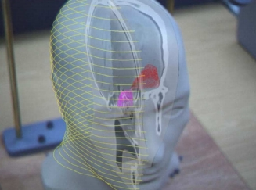
Advanced Medical Displays: A Literature Review of Augmented Reality
2008
Sielhorst, T., Feuerstein, M., Navab, N.

Slide 8
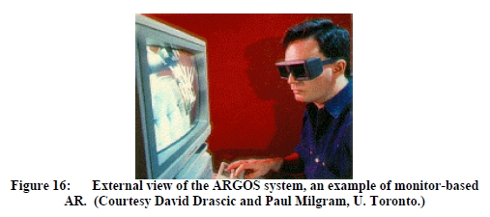

A Survey of Augmented Reality
1997
Ronald T. Azuma

Slide 9
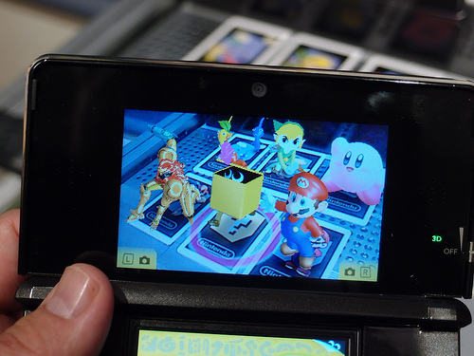

Nintendo 3DS

Slide 10
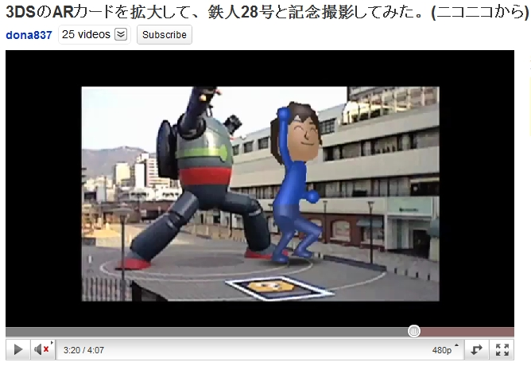
http://youtu.be/E1wU7iBHXz0

Slide 11
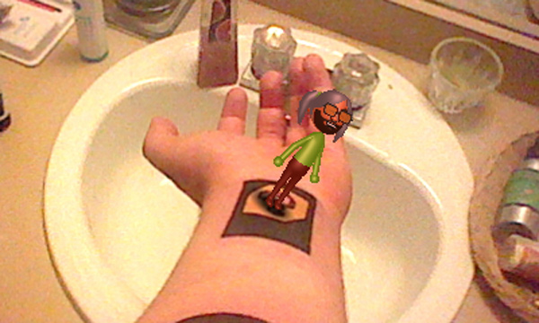

Slide 12
Alternate Reality Gaming
games that take reality and blend it with addition meaning through narratives and interaction
Where augmented reality is about objects, alternate reality is about stories

Slide 13

-Social Walking
-Discovering and exploring places
-Collecting
-Profile and statistics
-First to find: Competition and urgency
-Challenge: Individual and social aspects
"Understanding Geocaching Practices and Motivations"., Kenton O’Hara, HP Labs, 2008

Slide 14
"As an activity, geocaching was more than just the sum of the individual caching experiences. For many of the participants, there was a “collecting” ethos that was a significant part of the experience."
"Understanding Geocaching Practices and Motivations"., Kenton O’Hara, HP Labs, 2008

Slide 15

Necessary
Camera
GPS
Compass
Supplemental
Advanced GPS
Internet connected mobile devices
Larger mobile screens

Slide 16
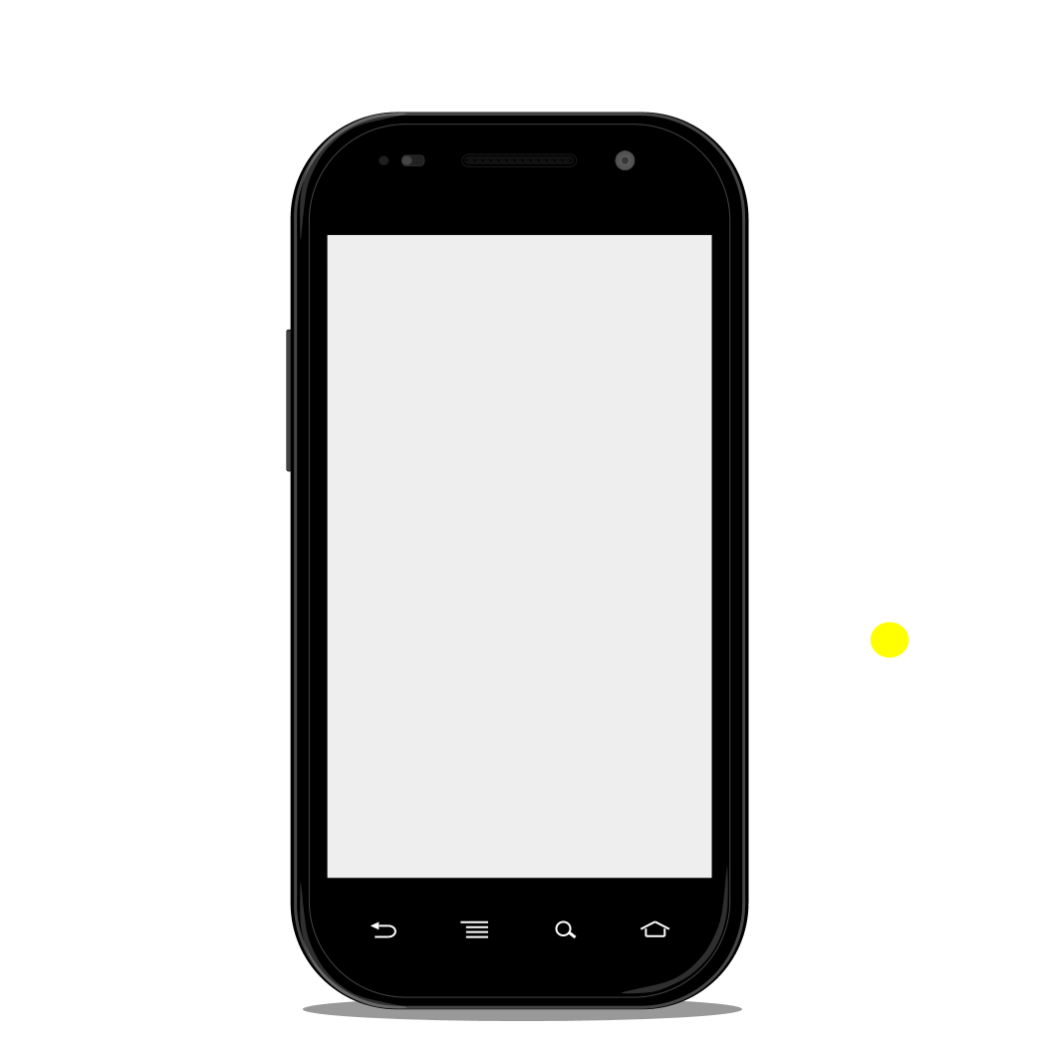

Slide 17
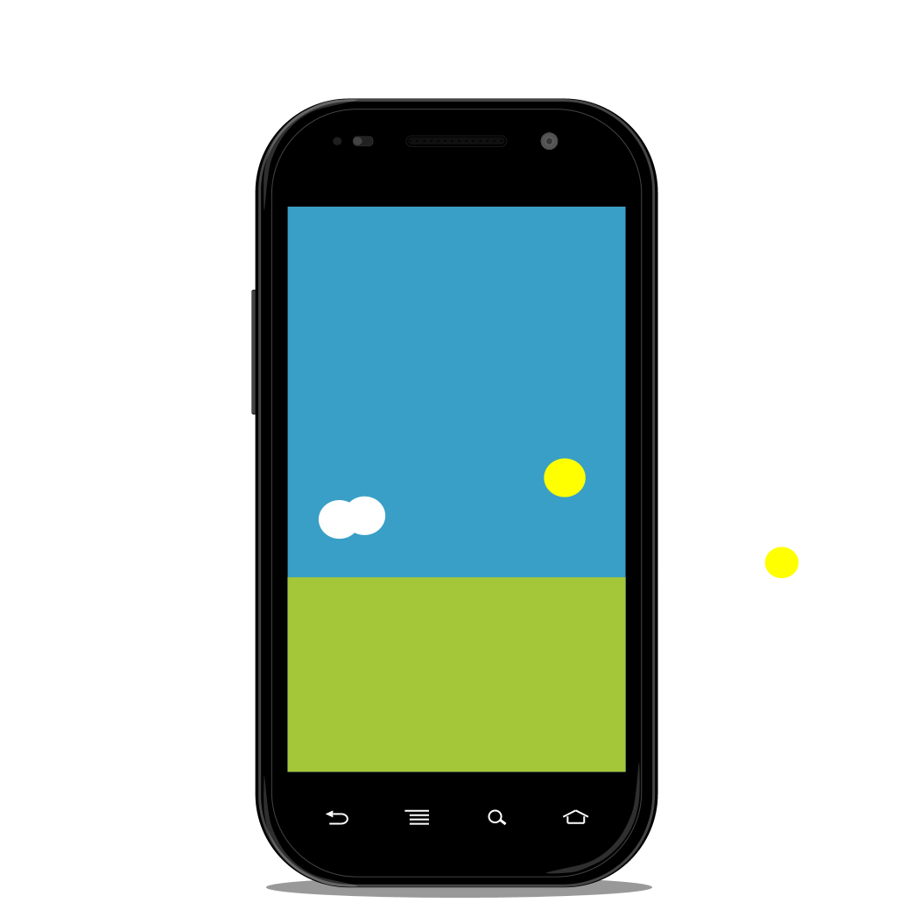

Slide 18
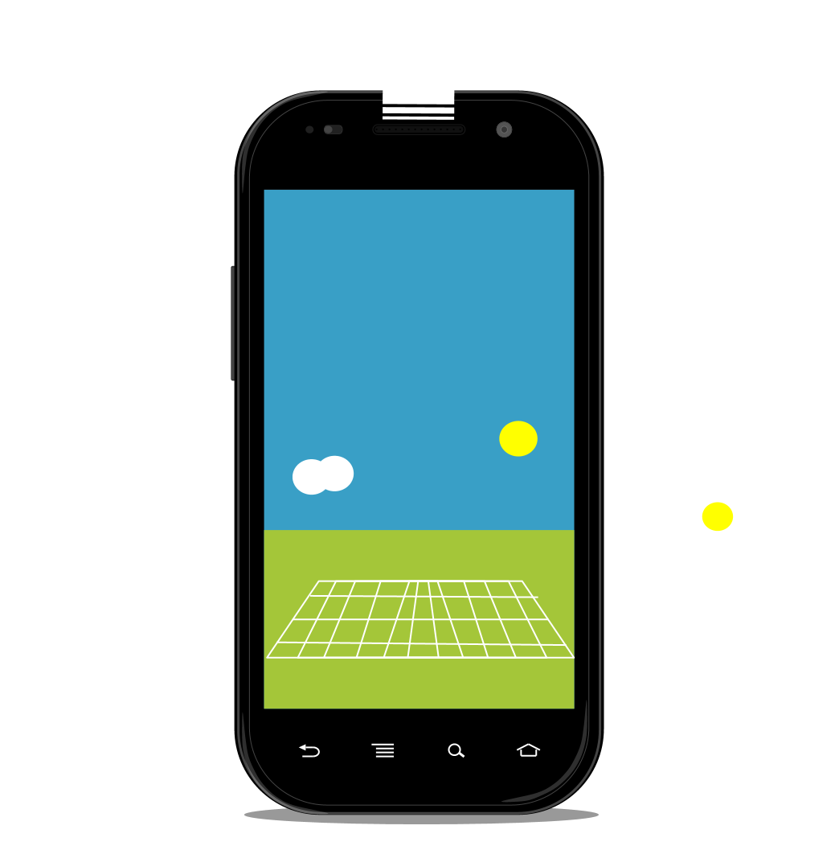

Slide 19
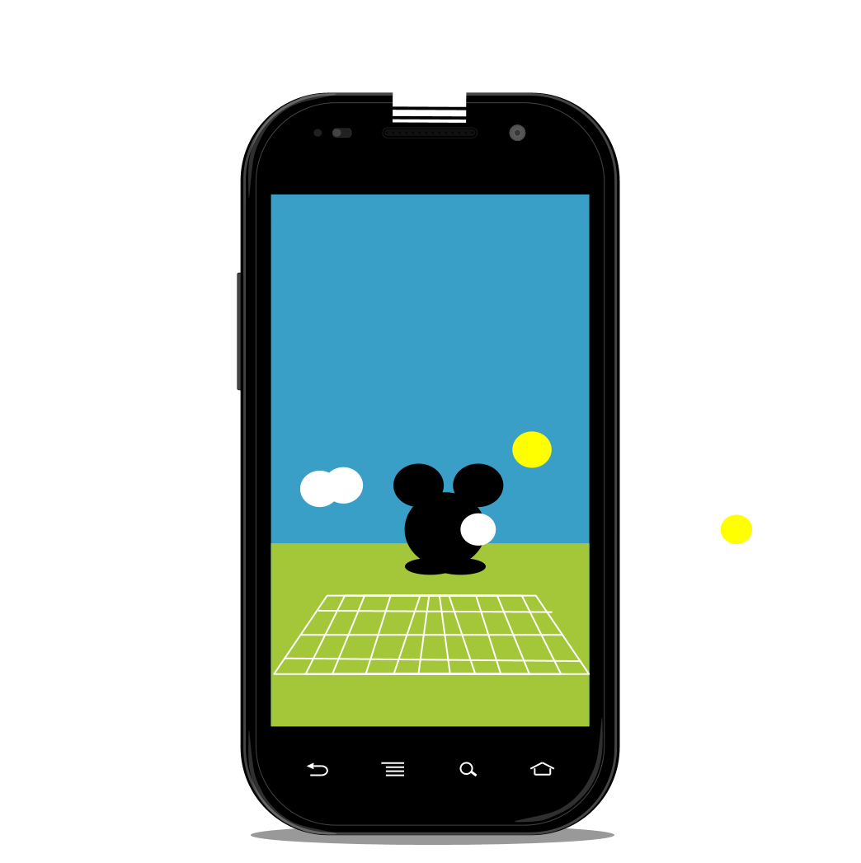



Slide 20
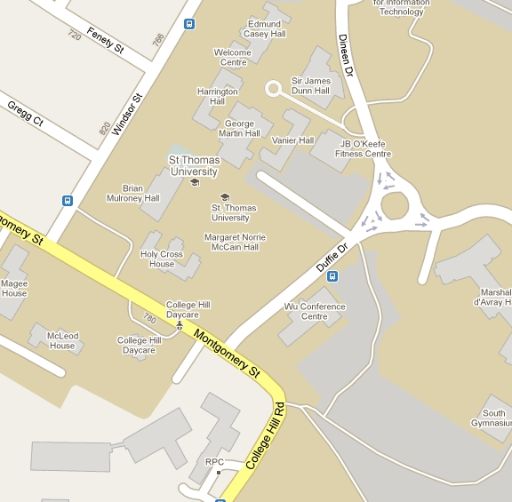

Slide 22
Layar
Augmented reality browser
> Sends your state to the Pico Safari server
location, options, phone, accuracy
< Server parses the parameters, does the math, and send back the appropriate information
name, buttons, points, descriptions, image urls, messages, urls for additional actions

Slide 23

Issues
Technical problems
Hardware availability
Social comfort

Slide 24


Slide 25
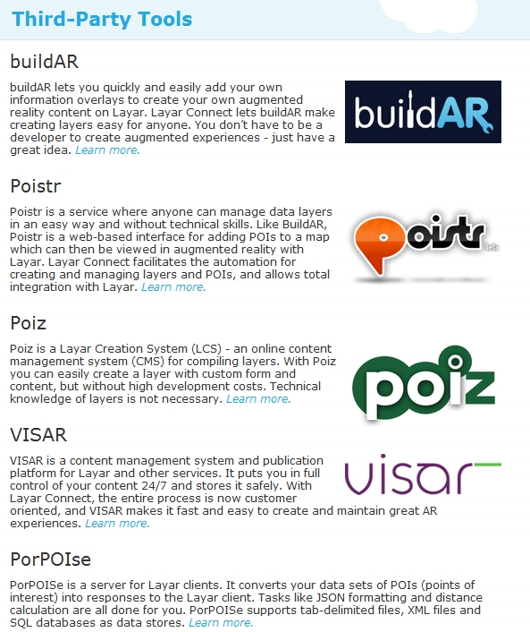


http://www.layar.com/development/tools/third-party-tools/

Slide 26
Thank you.
Acknowledgements
Geoffrey Rockwell
Sean Gouglas
Eleni Stroulia
Himanshu Vashishtha
Koosha Golmohammadi
SDH-SEMI 2011
Frederiction
Peter Organisciak, Garry Wong, Calen Henry, Lucio Gutierrez

Slide 27
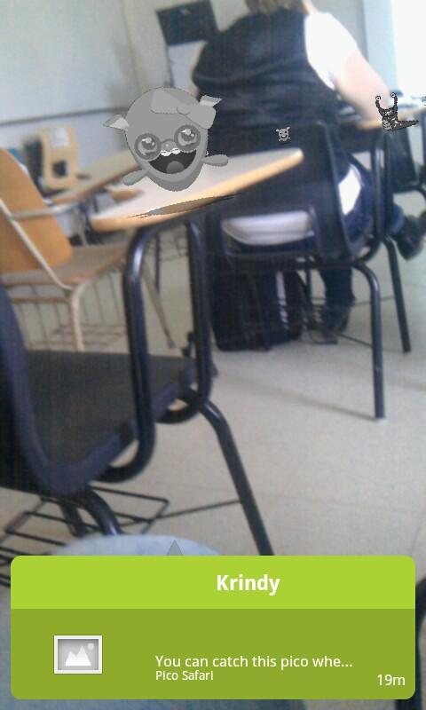
http://layar.it/kehxWp

